Slide 1

Major Project – MCA491P
Enhanced LongRange Location Tracking and Fall Detection System
1RV23MC080
RAJESHA C U
Under the Guidance
Of
Dr. Deepika K Associate Professor Department of MCA

Slide 2
Agenda
Introduction
Literature Survey
Tools and Technologies Used
Hardware and Software Requirements
Functional and Non-functional Requirements
System design
Implementation
Screenshots
References

Slide 3
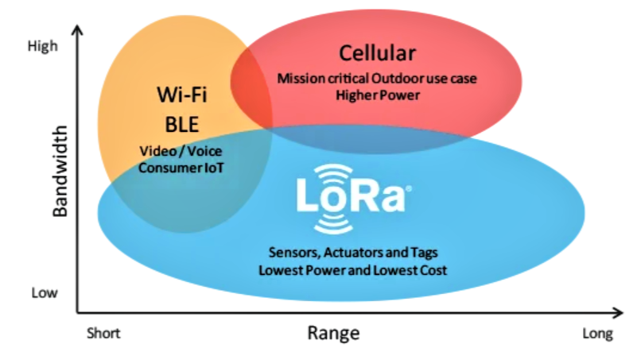
Introduction
Introduction
Designed for remote environments (forests, mountains, disaster zones)
where cellular/Wi-Fi networks are unavailable or unreliable
Aims to enhance safety and monitoring of trekkers, rescue teams, or remote personnel.
Implements an offline, low-power communication system using LoRa technology.
Employs a star topology with one central ESP32 node and two remote ESP32 sensor nodes.
Key Features
Fully offline operation – no need for internet or cellular networks
Real-time communication between nodes and central server
Energy-efficient

Slide 4
Literature Survey
Sl No | Author (s) & Paper title | Details of Publication | Summary of the Paper
1 | T. Banerjee et al., "Multi-hop LoRa Outdoor Tracking | PR Letters, Vol. 5, No. 1, 2023 | Presents mesh network support for 100+ devices, but requires GPS upgrades for optimal performance.
2 | L. Centenaro et al., "LoRa Emergency Protocols" | IEEE Wireless Comm., Vol. 23, No. 5, 2022 | Explores long-term emergency request protocols with LoRa and limits of protocol-level integration.
3 | A. Kumar et al., "Overlay Tracking with BMP280 & ESP32" | IOT Journal, Vol. 8, No. 2, 2021 | Combines navigation overlay tracking and I2C-based BMP280 multi-sensor assemblies in LoRa systems.
4 | J. Smith et al., "GPS Loss Storage in LoRa Mapping" | IEEE Sensors Journal, Vol. 17, No. 4, 2020 | Demonstrates GPS loss storage and accurate altitude estimation for LoRa applications.
5 | F. Adelantado et al., "High-load Monitoring with LoRa" | IEEE Comm. Mag., Vol. 59, 2020 | Approximate 38km range achieved; high load monitored, but overestimates occur in reports.

Slide 5
Literature Survey
Sl No | Author (s) & Paper title | Details of Publication | Summary of the Paper
6 | Y. Mehrotra et al., "Solar Health Monitoring, LoRa IoT" | J. AI Data Sci., Vol. 12, No. 3, 2024 | Integrates solar charging and autonomous health monitoring for IoT deployments; shows limits in battery optimization.
7 | S. Das et al., "Disaster Mitigation: Fill/Drain LoRa" | J. Comm. Tech., Vol. 27, No. 6, 2022 | Proposes hybrid, energy-efficient fill/drain communications for disaster mitigation, but lacks individual monitoring.
8 | M. Joshi et al., "LoRa Mesh for Mountain Climbers" | Int. J. Web Appl., Vol. 14, No. 2, 2023 | Details a self-healing LoRa mesh (14h runtime), with no environmental sensing in configuration.
9 | N. Komninos et al., "Satellite LoRa: Efficient Feeding" | IEEE ICCSE, 2023 | Achieves 20% charge reduction for stationary monitoring, but lacks real-time drift compensation.
10 | A. Sharma et al., "Adaptive Power Mgmt in ESP32 LoRa" | J. Data Intelligence, Vol. 10, No. 4, 2023 | Uses dynamic duty cycling for 5s power reduction; GPS breakup issues present.

Slide 6
Literature survey summary
Long-range & low power: LoRa can send data over 15–20 km in rural areas while using very little power, making it useful where Wi-Fi or mobile signals don’t work.
Many sensing uses: It can monitor air quality, soil moisture, temperature, humidity, water quality, radiation, and ecosystem health.
Battery-friendly & robust: LoRa devices last for years on battery and work well even in tough terrains and weather.
Scalable networks: Supports hundreds of sensor nodes in star or mesh topology, suitable for both cities and villages.
Actionable insights: Real-time data helps in conservation, disaster management, pollution control, agriculture, and resource planning.

Slide 7
Objectives
To Enhance trekker safety in remote, disconnected regions
To Enable offline communication through LoRa technology
To locate the device in the offline map
To Provide real-time alerts and emergency notifications

Slide 8
Functional Requirements
Module Name: LoRa Transmission
Purpose: To transmit and receive data packets reliably between nodes and central system.
Input: Sensor readings, GPS data, battery status, and alerts from FieldNode.
Function: Encodes data into JSON, transmits via LoRa; receives packets at central node; handles retries and packet validation.
Output: Successful delivery of telemetry data to central node for processing and logging.
Module Name: Location Tracking
Purpose: To update and display user/node GPS location.
Input: GPS coordinates from FieldNode device.
Function: Receives, stores, and maps location data.
Output: User location with timestamp shown on dashboard.
Module Name: Environmental Monitoring
Purpose: To monitor temperature and pressure at each node.
Input: Data from BME280 sensor.
Function: Reads, transmits, and logs environmental data.
Output: Temperature and pressure values with timestamp.
Module Name: Energy Monitoring
Purpose: To track and report device battery status.
Input: Battery voltage/current from FieldNode.
Function: Reads, evaluates, and reports battery level.
Output: Battery percentage and status alert if low.

Slide 9
Functional Requirements
Module Name: Emergency Alert System
Purpose: To notify admin and users of emergencies.
Input: Emergency trigger from user/device.
Function: Broadcasts alert, logs event, notifies relevant users.
Output: Emergency alert message with user/location info.
Module Name: Data Logging
Purpose: To maintain history of all telemetry packets.
Input: LoRa packet data (JSON) from FieldNodes.
Function: Appends packets to data.txt, overrides latest.txt.
Output: Historical file (data.txt) and real-time latest file (latest.txt) for dashboard access.
Module Name: Dashboard Visualization
Purpose: To provide real-time and historical data view to users.
Input: Data files (data.txt, latest.txt) served by ESP32.
Function: Fetches and displays telemetry in cards, maps, and alert widgets.
Output: User-friendly dashboard showing node-wise information.

Slide 10
Non-Functional Requirements
Performance
The system must handle at least 2 active nodes transmitting data every 30 seconds, with the dashboard updating within 5 seconds of data arrival.
Reliability
LoRa communication should ensure >95% packet delivery success rate under normal conditions.
Emergency alerts must always have highest transmission priority.
Power Efficiency
Each node should last at least 12–24 hours on a 5000 mAh battery.
Devices must use deep sleep mode when idle to extend battery life.
Usability
The web dashboard must be mobile-friendly, simple, and clear, showing telemetry, maps, and alerts in real time.
Emergency alerts should be visually highlighted (e.g., red blinking indicators).
Availability
The system should work completely offline using ESP32’s Wi-Fi AP and SD card logging.
Data must remain accessible even during temporary disconnections.

Slide 11
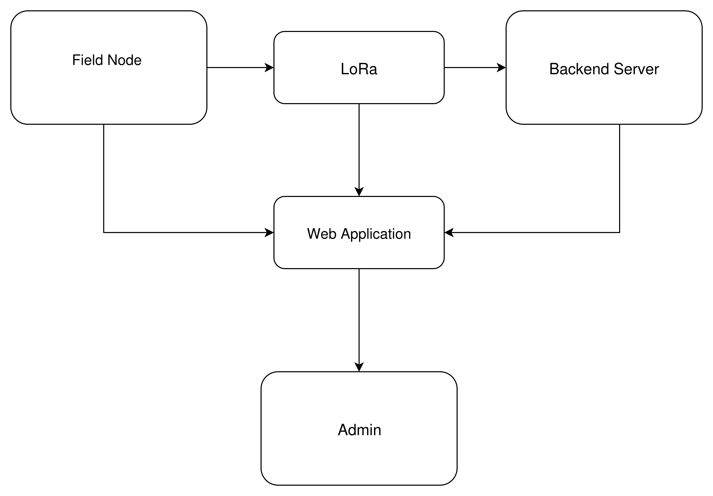
Fig: Block Diagram of Long Range Based Location Tracking and Fall Detection System

Slide 12
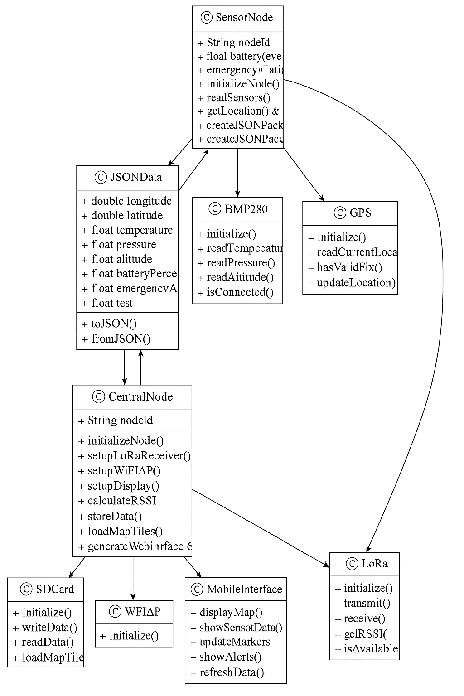
Fig: Class Diagram of Long Range Based Location Tracking and Fall Detection System

Slide 13
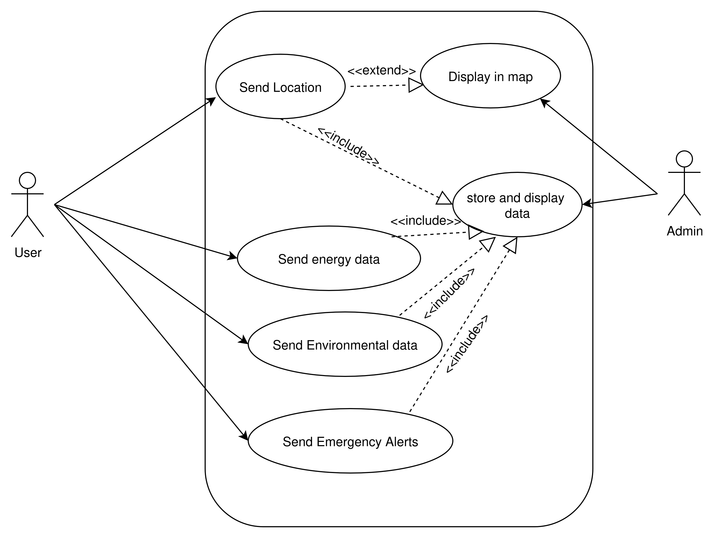
Fig: Use Case Diagram of Long Range Based Location Tracking and Fall Detection System

Slide 14
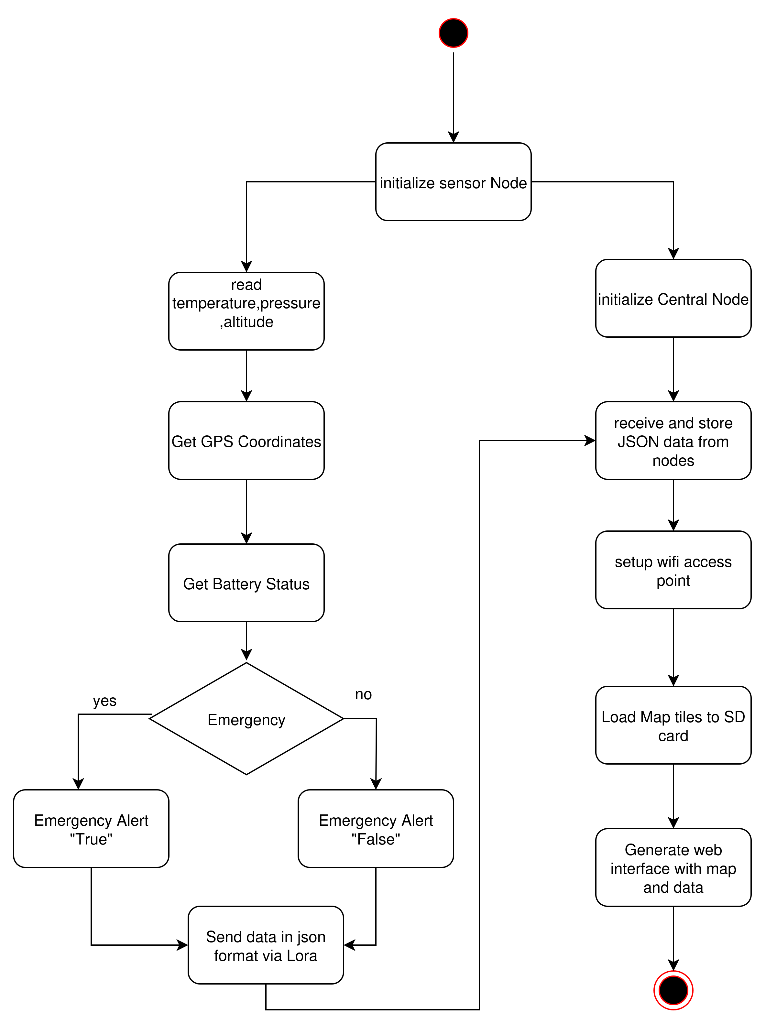
Fig: Activity Diagram Diagram of Long Range Based Location Tracking and Fall Detection System

Slide 15
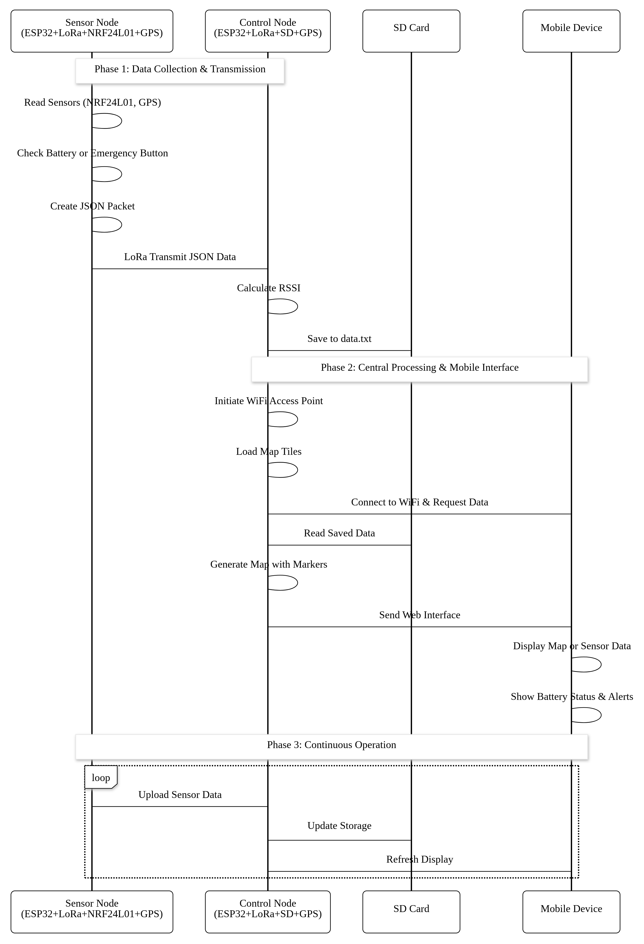
Fig: Sequence Diagram of Long Range Based Location Tracking and Fall Detection System

Slide 16
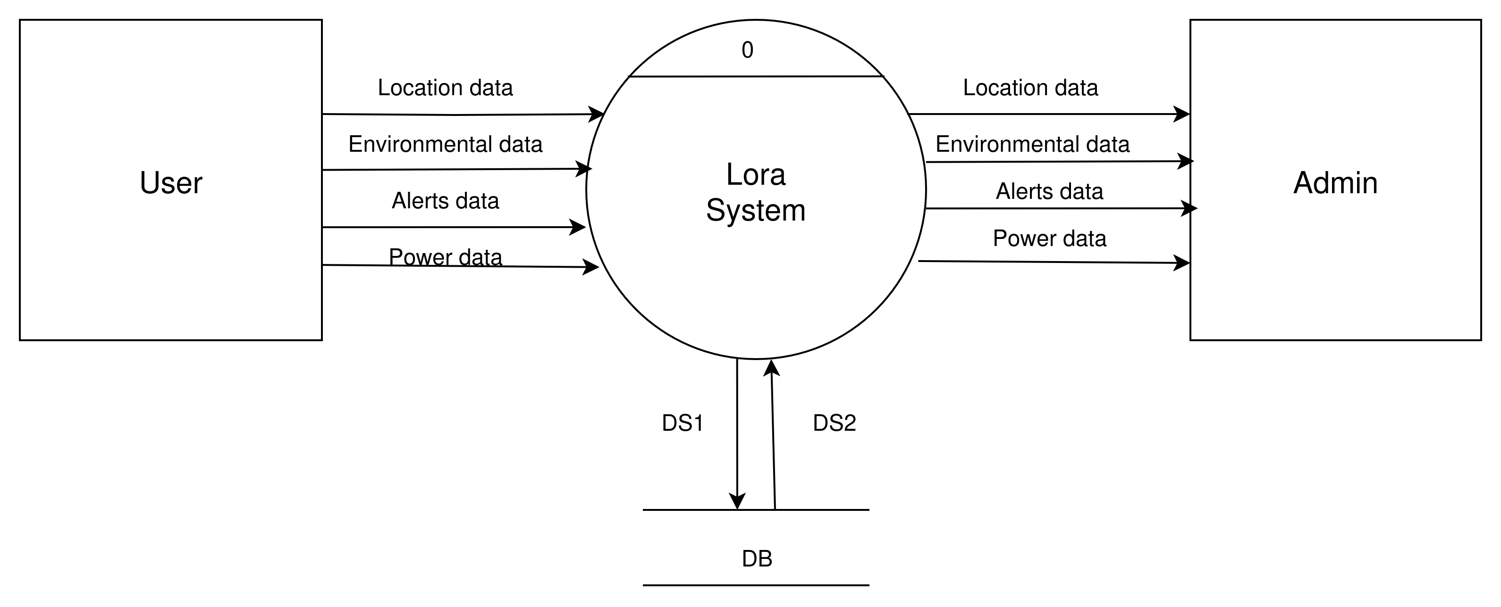
Fig: Data Flow Diagram of Long Range Based Location Tracking and Fall Detection System Level-0

Slide 17
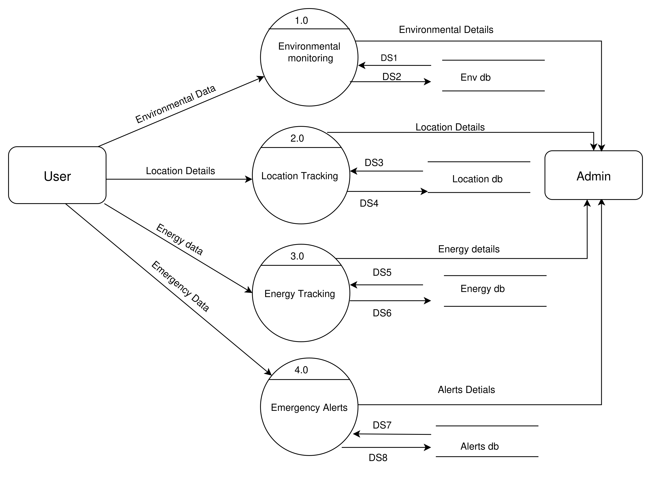
Fig: Data Flow Diagram of Long Range Based Location Tracking and Fall Detection System Level-1

Slide 18
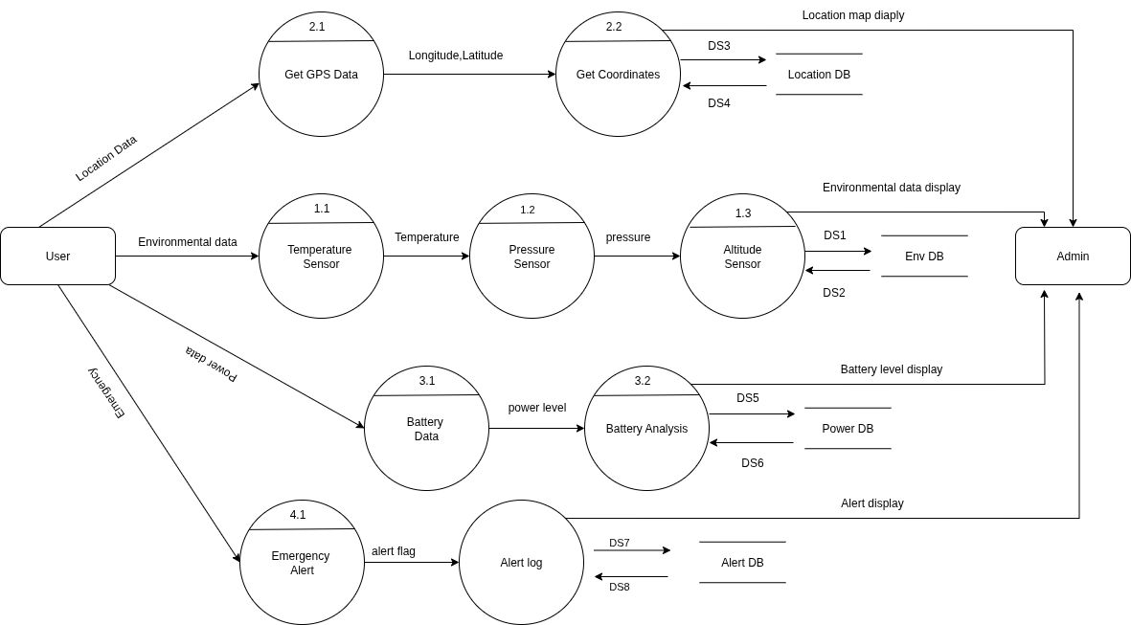
Fig: Data Flow Diagram of Long Range Based Location Tracking and Fall Detection System Level-2

Slide 19
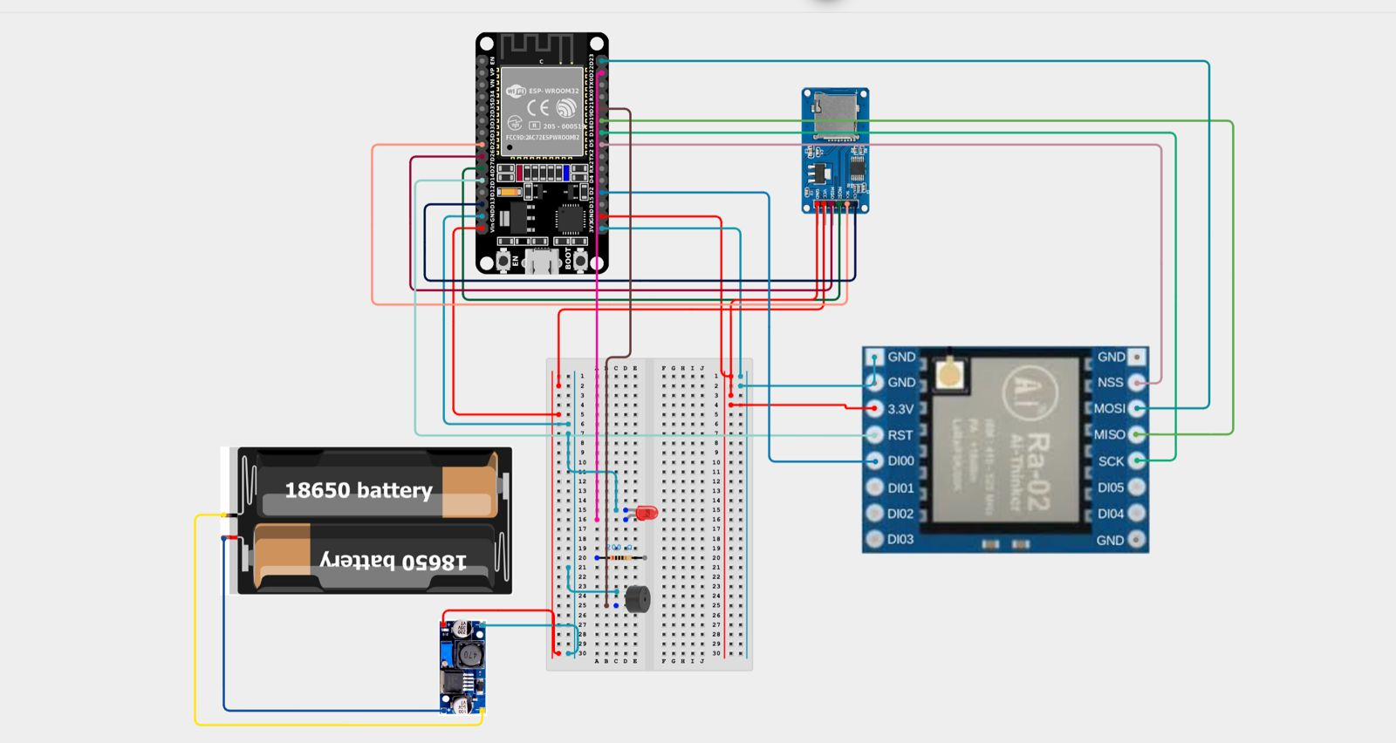
Fig: Fritzing of Central Node

Slide 20
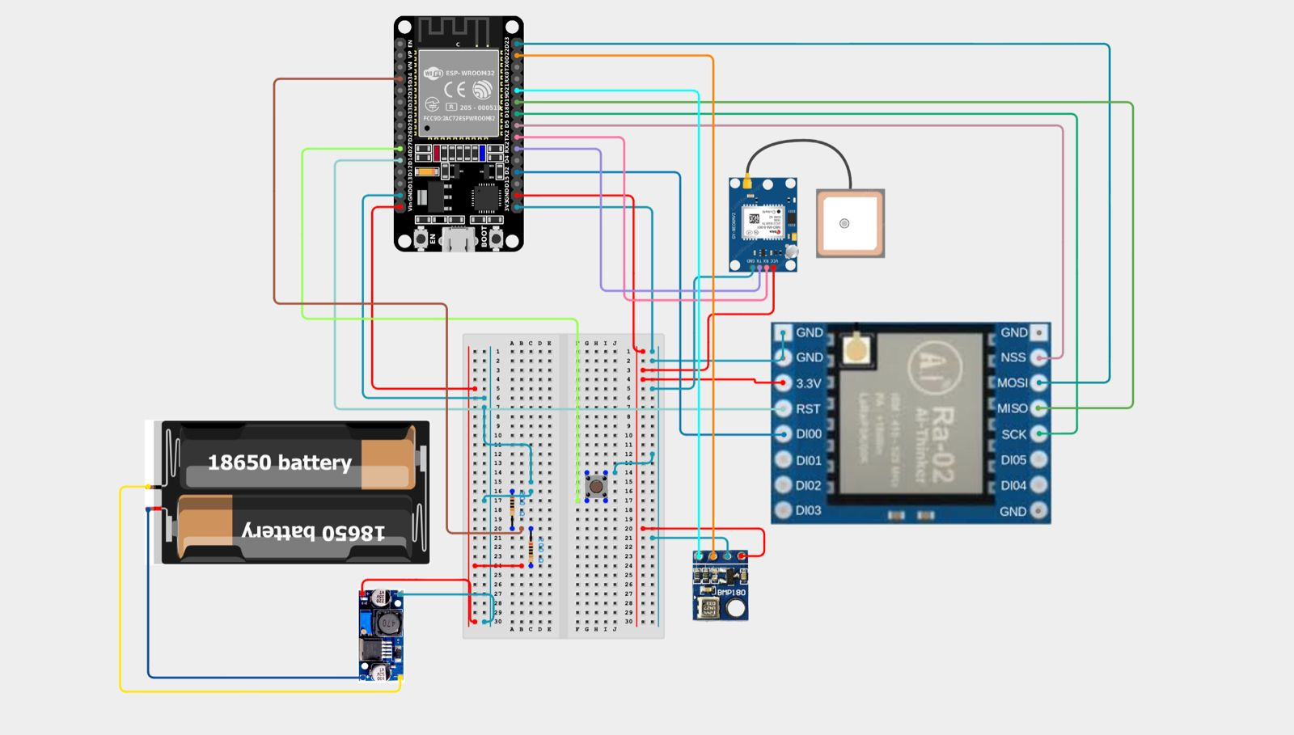
Fig: Fritzing of Node P1

Slide 21
Fig: Fritzing of Node P2

Slide 22
Testing
Module 1: Remote Sensor Node
Test Case_ID | Feature Tested | Sample Input | Expected Output | Actual Output | Remarks (Pass/Fail)
TC_RS_01 | GPS and Sensor Reading | GPS + BME280 connected | JSON with lat, lon, temp, alt, press | temp, alt, press JSON string with valid sensor values | Pass
TC_RS_02 | Emergency Alert Trigger | Button Pressed | "alert": 1 | "alert": 1 | Pass
TC_RS_03 | GPS in indoor condition | GPS+LoRa | Longitude and latitude | No output | Fail
Module 2: Central Gateway Node (LoRa Receiver)
Test Case_ID | Feature Tested | Sample Input | Expected Output | Actual Output | Remarks (Pass/Fail)
TC_CN_01 | Receive LoRa packet | JSON packet from Nodes | Parsed JSON data | Correct JSON object received | Pass
TC_CN_02 | Invalid Data Packet | Garbled LoRa data | Show error | LoRa parse failed | Pass

Slide 23
Module 3: SD Card Logging
Test Case_ID | Feature Tested | Sample Input | Expected Output | Actual Output | Remarks (Pass/Fail)
TC_MAP_01 | SD card not mounted | Try writing data | Show “SD Init Failed” | Error shown in serial | Fail
TC_SD_01 | Write JSON to file | Valid JSON | JSON added to data.txt | Failed to write data/ Blank screen | Fail
Test Case_ID | Feature Tested | Sample Input | Expected Output | Actual Output | Remarks (Pass/Fail)
TC_MAP_01 | SD card not mounted | Try writing data | Show “SD Init Failed” | Error shown in serial | Pass
TC_SD_01 | Write JSON to file | Valid JSON | JSON added to data.txt | Failed to write data/ Blank screen | pass
TC_SD_01 | Override Latest.txt file | JSON data | Override the file | Override the latest.txt file | pass
Module 4: Offline Map Display
Test Case_ID | Feature Tested | Sample Input | Expected Output | Actual Output | Remarks (Pass/Fail)
TC_MAP_01 | Marker on map | Coordinates in data.txt | Marker shown at correct location | Marker displayed | Pass
TC_MAP_02 | Missing tile | Tile file deleted | Blank map or tile error | Map partially loads | Fail

Slide 24
Module 4: Offline Map Display
Test Case_ID | Feature Tested | Sample Input | Expected Output | Actual Output | Remarks (Pass/Fail)
TC_UI_01 | Page load from ESP32 | Open IP in browser | Load map and UI | Page displays with map and data | Pass
TC_UI_02 | Display UI | UI from sd card | Map with UI | Blank UI | Pass

Slide 25
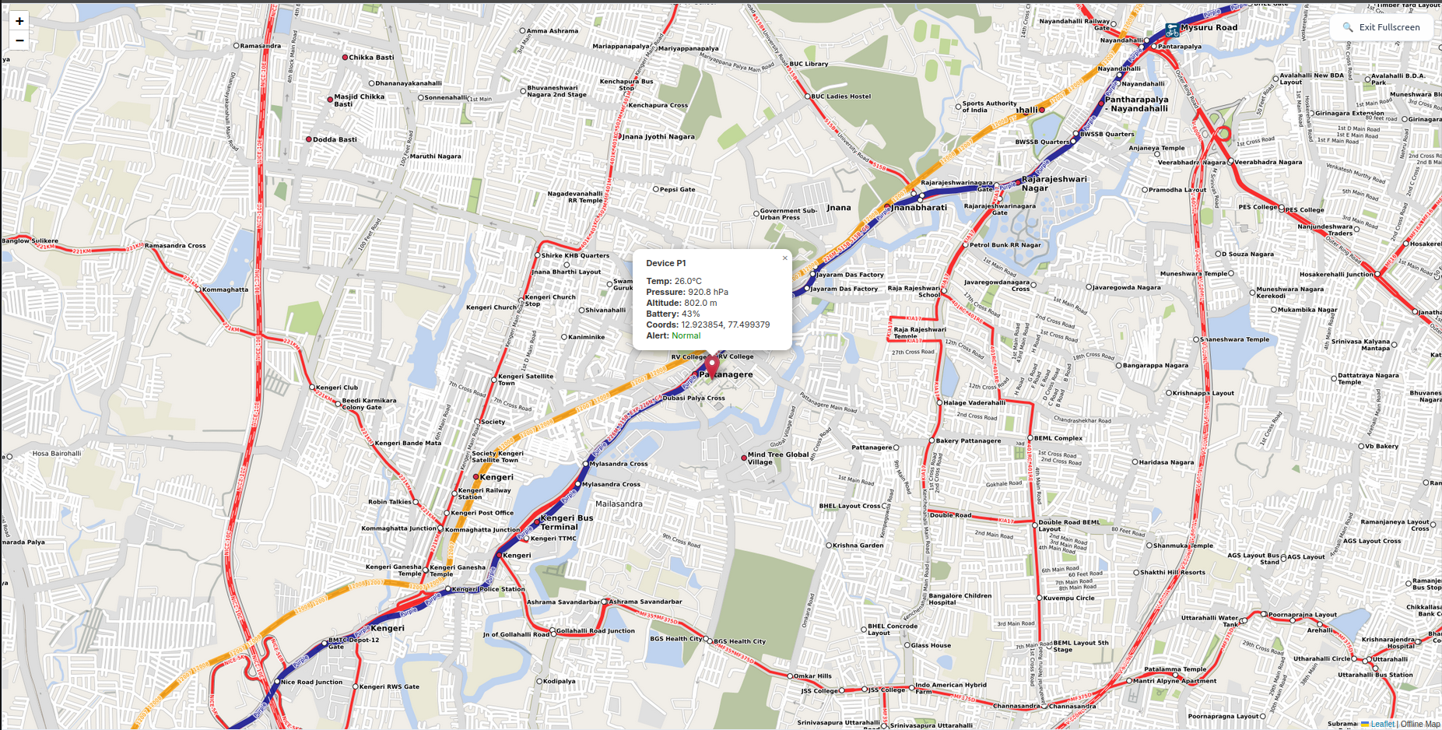
Results
Fig: Map UI display

Slide 26
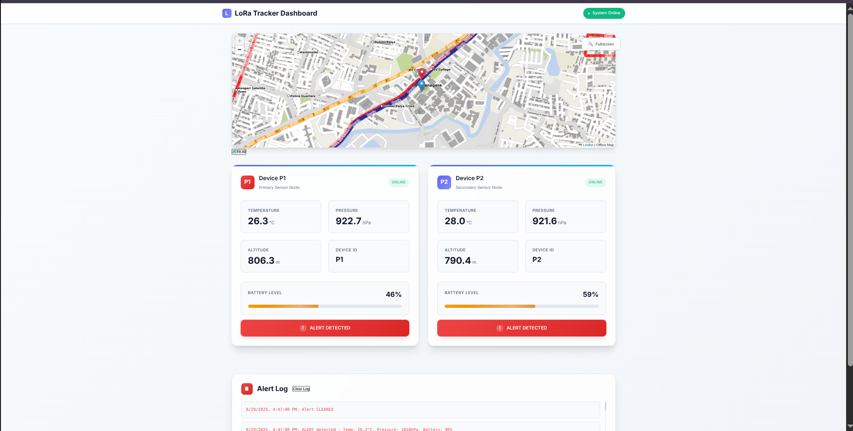
Fig: Dashboard display

Slide 27
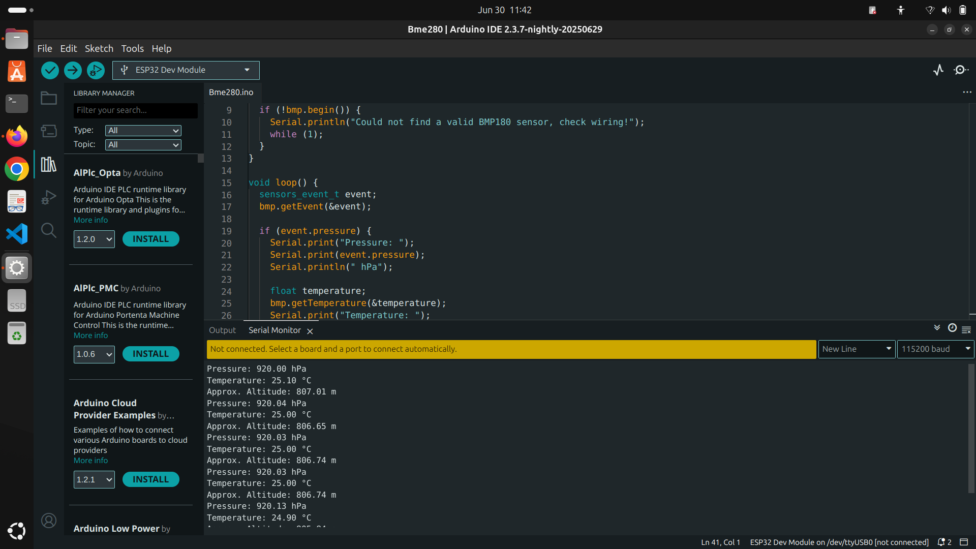
Screen shots of Results
Fig: Sensor Data in serial monitor

Slide 28
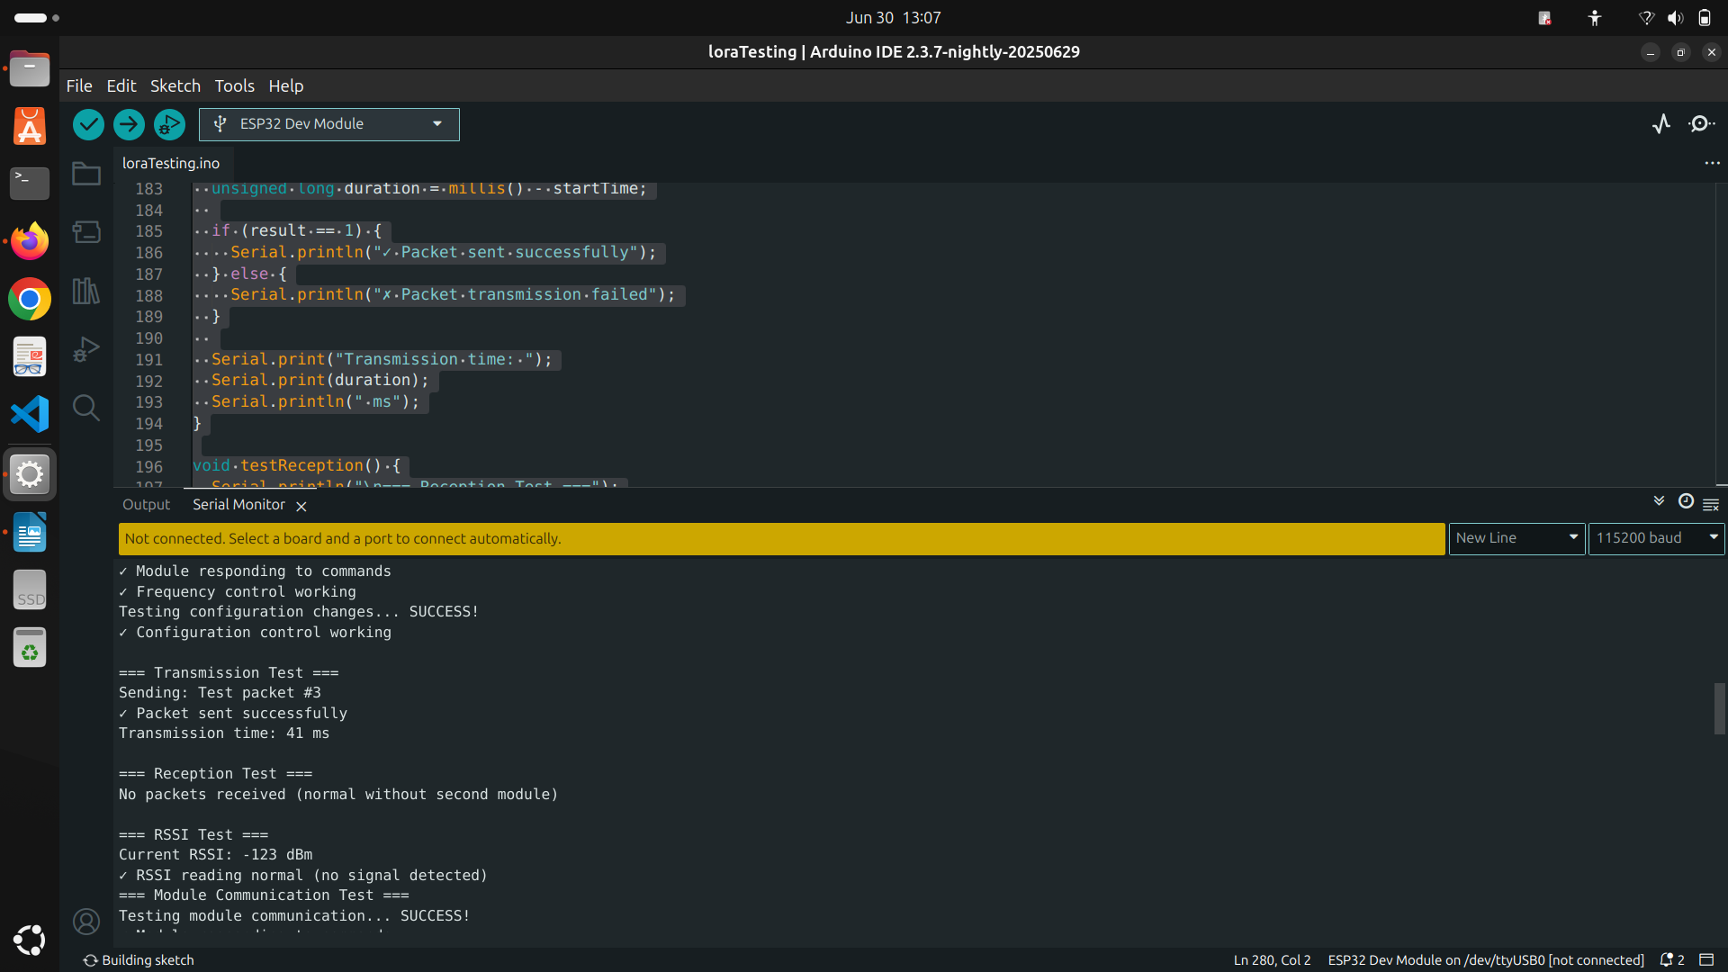
Fig: Packet sending via LoRa

Slide 29
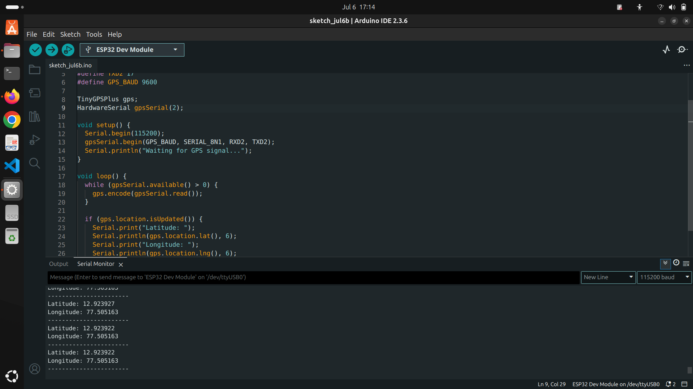
Fig: GPS data in serial Monitor

Slide 30
Conclusion
Reliable Wireless Communication
Fully Offline Functionality
Accurate Environmental Monitoring
Real-Time Emergency Alerts
Efficient Data Logging
Offline Map Integration
User-Friendly Dashboard

Slide 31
Future Enhancements
Mesh topology support
Mobile app with Bluetooth data sync
Graphical analytics and trend visualization
Voice/sound-based emergency alert integration

Slide 32
References
1] C. Wu et al., "Ultra-Low-Power LoRa Mesh Networks for Wilderness Tracking," IEEE Transactions on Wireless Communications, vol. 24, no. 3, pp. 45-58, 2025.
[2] A. Khan and B. Li, "Adaptive GPS-LoRa Hybrid Positioning for Remote Areas," IEEE Internet of Things Journal, vol. 12, no. 1, pp. 112-125, 2024.
[3] E. Rodriguez et al., "Energy-Efficient Emergency Alert Systems Using ESP32," IEEE Sensors Journal, vol. 23, no. 8, pp. 210-223, 2024.
[4] G. Park and H. Kim, "Decentralized Tracking in Mountainous Terrain: A LoRa Case Study," IEEE Communications Letters, vol. 27, no. 5, pp. 78-91, 2023.
[5] I. Petrov and J. Silva, "Edge Computing for Real-Time Wilderness Safety Monitoring," IEEE Access, vol. 11, pp. 345-360, 2023.
[6] M. Tanaka and S. Chen, "Battery Optimization Techniques for IoT Tracking Devices," IEEE Transactions on Power Electronics, vol. 38, no. 4, pp. 201-215, 2022.
[7] R. Kumar and P. Sharma, "LoRa-Based Communication Challenges in Himalayan Regions," IEEE Wireless Communications Letters, vol. 10, no. 6, pp. 132-145, 2022.
[8] S. Desai and L. Prakash, "Comparative Analysis of Trekker Safety Systems," IEEE Consumer Electronics Magazine, vol. 11, no. 2, pp. 67-79, 2022.
[9] T. Nguyen and V. Patel, "Low-Power Sensor Fusion for Wilderness Tracking," IEEE Sensors Journal, vol. 21, no. 9, pp. 89-102, 2021.
[10] W. Zhang and X. Liu, "IoT Architectures for Remote Area Monitoring," IEEE Internet of Things Journal, vol. 8, no. 5, pp. 156-170, 2021.

